Slide 1


The case for responsible purchasing

Slide 2
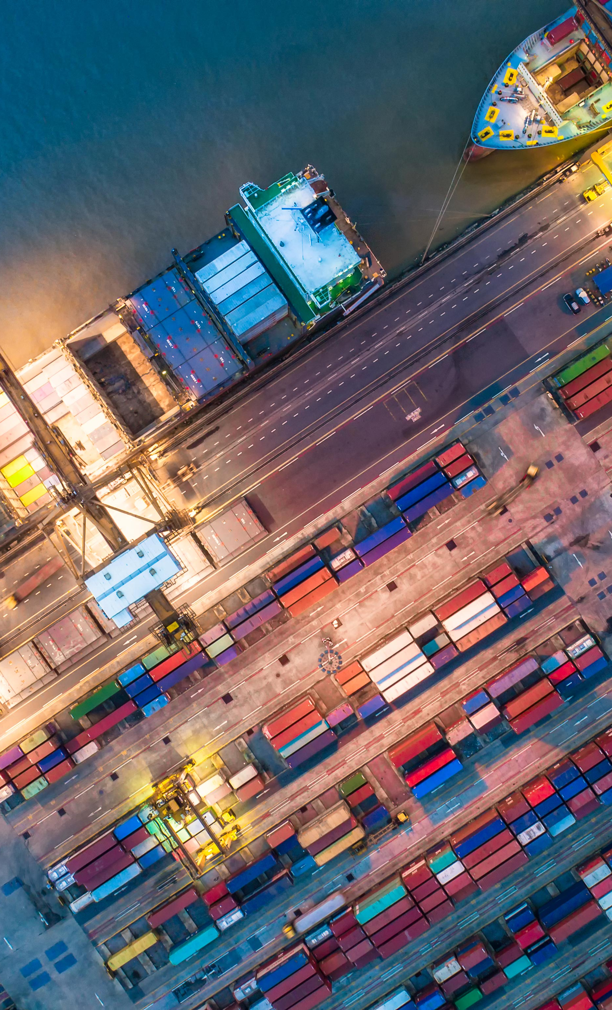
Introduction
Responsible Purchasing
In most organizations, the bulk of social and environmental impacts occurs in the supply chain
Responsible purchasing involves supplier risk assessments, continuous engagement and clear improvement objectives
The regulatory landscape has evolved to consider supply chain issues, such as modern slavery
COVID has highlighted the importance of resilient supply chains
A supply chain is only as strong as its weakest link.

Slide 3



Key Issues
Disruption
Regulation
Stakeholder Expectations
75% of Companies in the Institute for Supply Chain Management’s COVID Survey Reported Supply Chain Disruptions
(Source: Industry Week)
In addition to hazardous materials rules, supply chain human rights laws are being adopted around the globe. In the U.S., the bipartisan Slave-Free Business Certification Act was introduced to Congress in 2020.
More than three-fourths (86%) of shoppers think transparency is more important than ever, and 73% are willing to pay more for products that are reliably transparent.
(Source: Thomas)
MYTH:
People cared less about sustainability during the pandemic.
According to a report by Accenture, 45% of consumers have started making more sustainable shopping selections in the wake of COVID-19.

Slide 4

Benefits
Summary of Proven Business Benefits
Increasing sales and profits
Minimizing risk
Satisfying customers and shareholders
Building competitive advantage
Reducing costs
Strengthening supplier relationships and performance
(Source: Sustainable Leadership Council)

Slide 5
MODIFY THE FOLLOWING THREE SLIDES
WITH YOUR OWN DATA. DELETE ANY
NON-APPLICABLE SLIDES.
DELETE THIS SLIDE.

Slide 6

Revenue
1,250
Customers who inquired about our sustainability performance in the past 12 months
$10.5M
Revenue from customers who inquired about our sustainability performance in the past 12 months
25
Requests for proposal/quote containing questions about our sustainability performance in the past 12 months

Slide 7

Reputation
$75M
Business in markets with compliance requirements for human trafficking or modern slavery or environmental disclosure
$50B
Market capitalization of investors who inquired about our sustainability performance in the past 12 months
7
Key competitors who have launched responsible purchasing programs with full-time staff

Slide 8
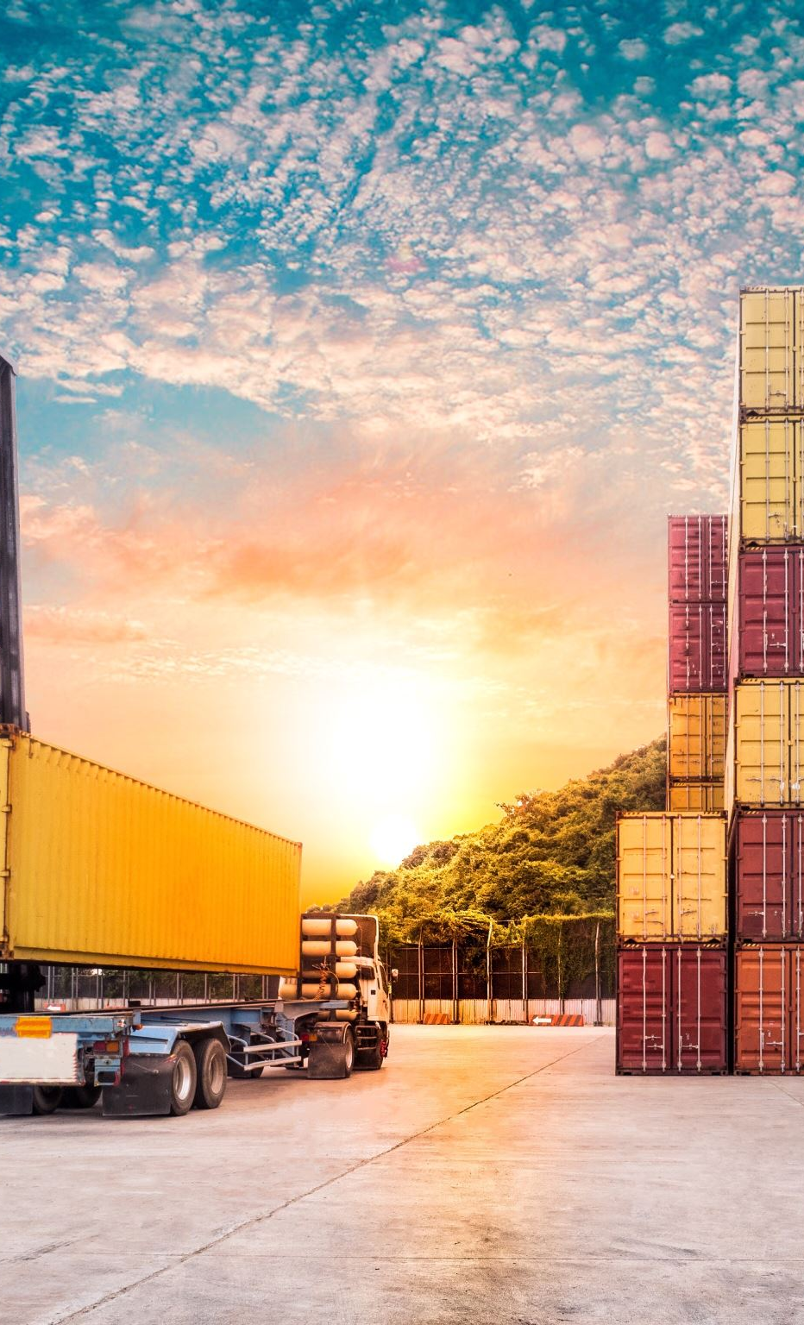
Risk
$7M
Procurement spend in countries at risk of corruption, human rights violations and environmental degradation over the past year
$4M
Procurement spend in industries at risk of unfair labor practices, human trafficking and pollution over the past year
5
Critical suppliers reported disruption in operations due to natural disasters or public health concerns last year

Slide 9

Opportunities
Supply chain responsibility means
we engage with suppliers to identify risk and launch corrective actions,
we help suppliers reduce risk-related costs to buffer against future price shocks,
we set targets to track key supplier performance, and
we report outcomes to our stakeholders.

Slide 10

Please contact [your.email.address] with questions or feedback.
Thank you.

