Slide 1
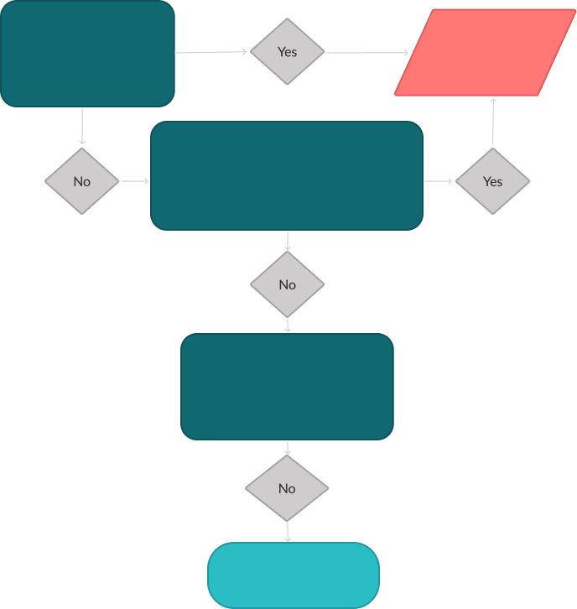

Supplier Assessment Prioritization Flowchart (Template)
To determine whether a supplier should be prioritized for your initial risk assessment, use this flow as a template. Adjust data in yellow font as needed. Refer to the “Workiva Carbon list of risk countries and industries" download to determine if this is a risk factor.
Be sure to share the flowchart with your sourcing team for reference.
Does the supplier operate in a high-risk country or industry
High-priority supplier,
send questionnaire
Is the supplier’s annual revenue >$250K or >20 employees or are they a critical supplier?
Has a public search turned up any adverse actions in the past 12 months?
Low-priority supplier

